Slide 1
It’s all about the aesthetics – dataviz with ggplot2::theme()
by Jess Tam
Notes:
hi!
I’ll quickly go through the presentation and then we can dig into the code -> if you have your own data you can also work on that
I’ll be using figures I’ve made since I am familiar with the design process

Slide 2
What is wrong with the default theme?
‘if it ain’t broke, don’t fix it’
Notes:
- If it is working well and showing what we want, why do anything to change it?

Slide 3
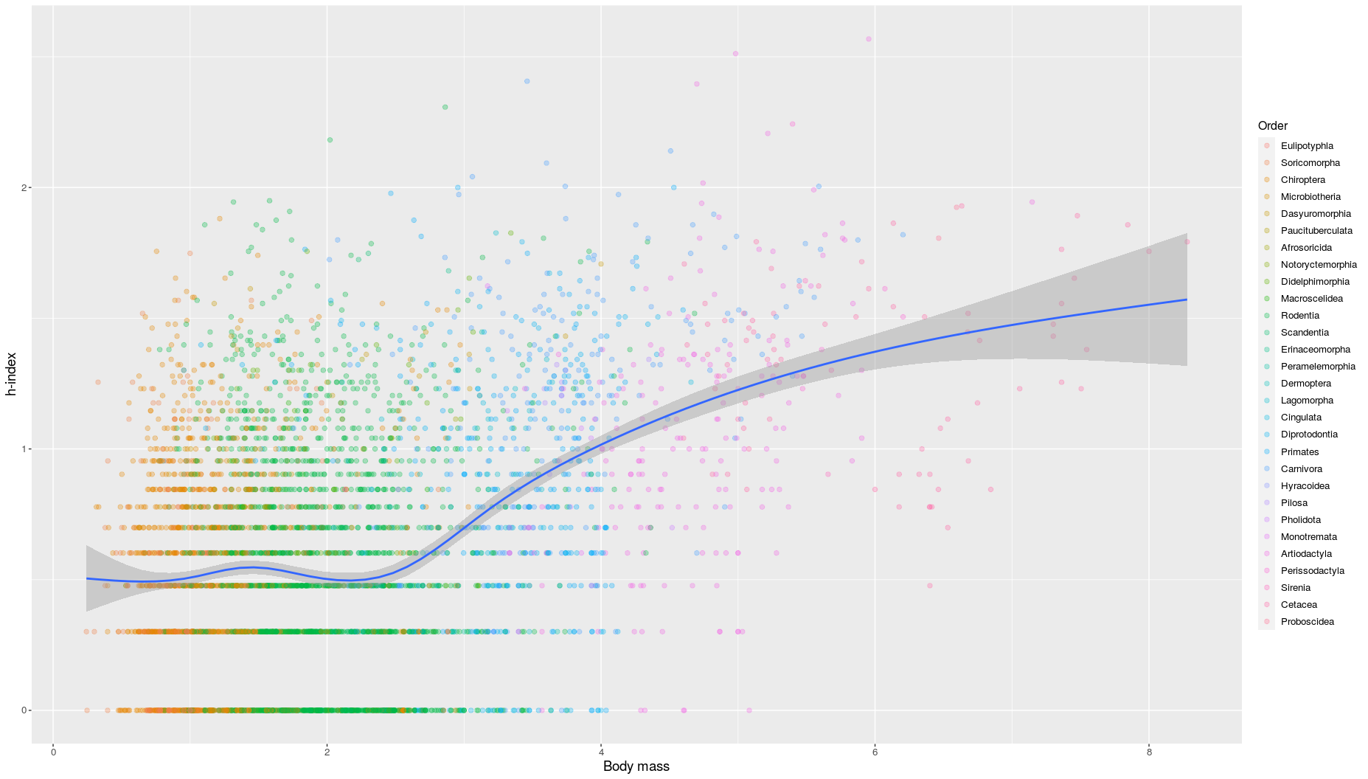
Notes:
Ggplot has their own default theme & colour palette -> very convenient and data looks presentable
Nothing wrong w/ using default theme
But we want our figures to look good & unique!
~ we want our voice to come through in our writing → we want to show our design language
Papers can be boring to read, you want to keep your audience engaged
It’s fun!

Slide 4
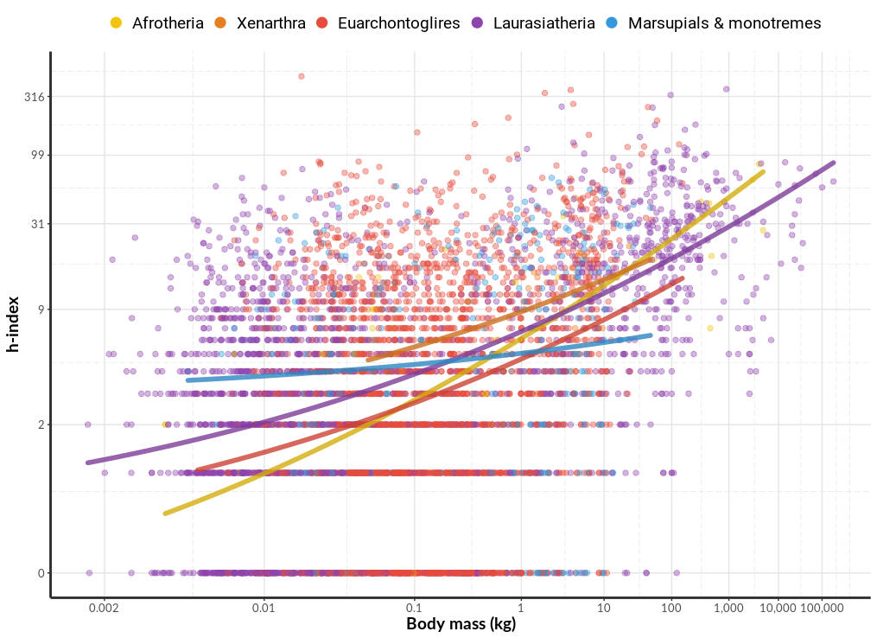

Slide 5
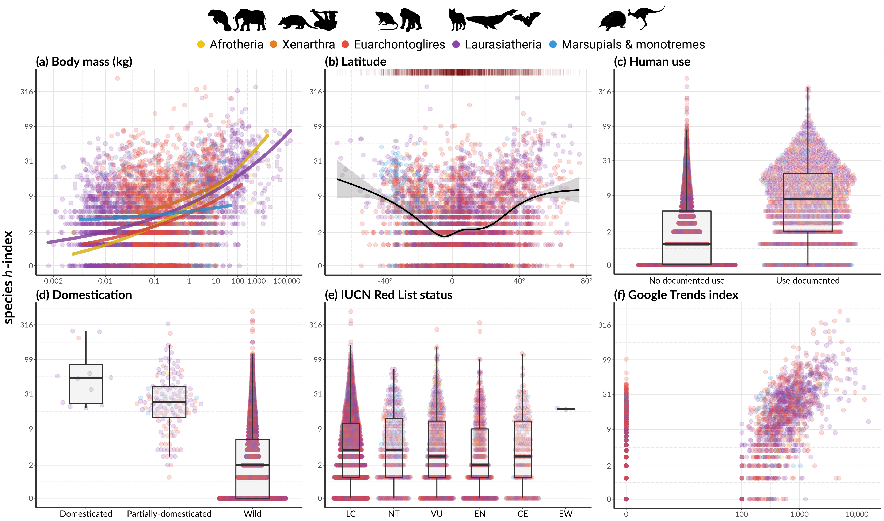

Slide 7
Pre-made themes
Built-in themes
theme_minimal()
theme_classic()

Slide 8
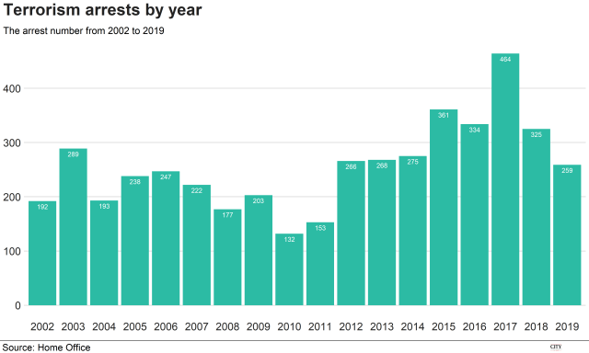

Slide 9
Pre-made themes
Built-in themes
theme_minimal()
theme_classic()
Community themes
bbplot()
ggtech()

Slide 10
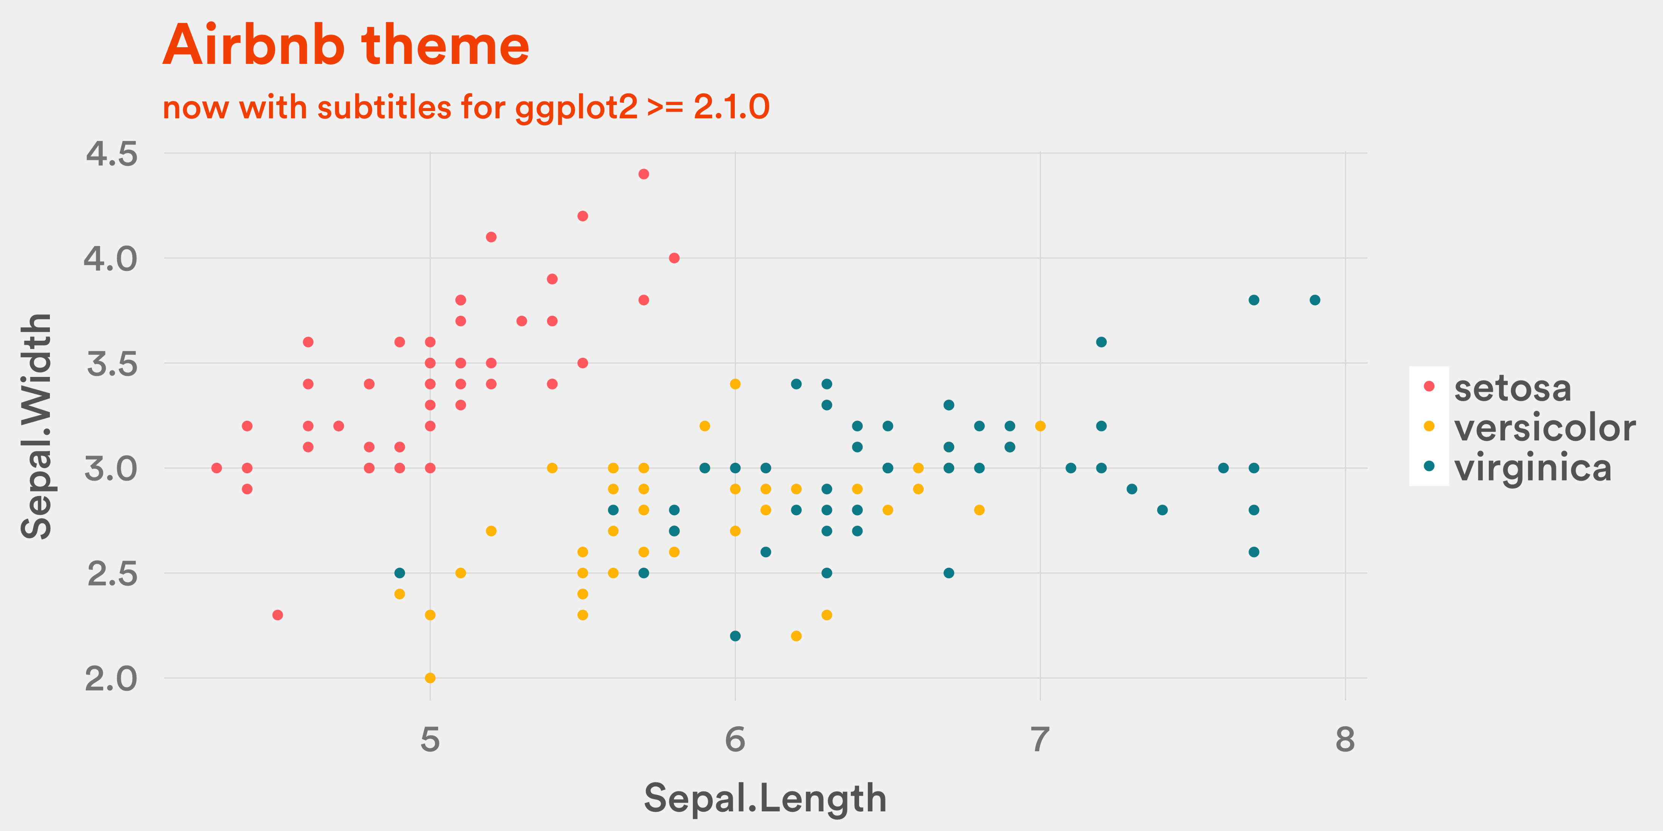

Slide 11
Considerations
Colour palettes
Check for colour-blind friendliness
Readability vs aesthetics
Old people can’t see small text
Your design language
Minimalist? Monochrome? Vibrant colours?
Try different geom_*() to visualise the same data

Slide 12
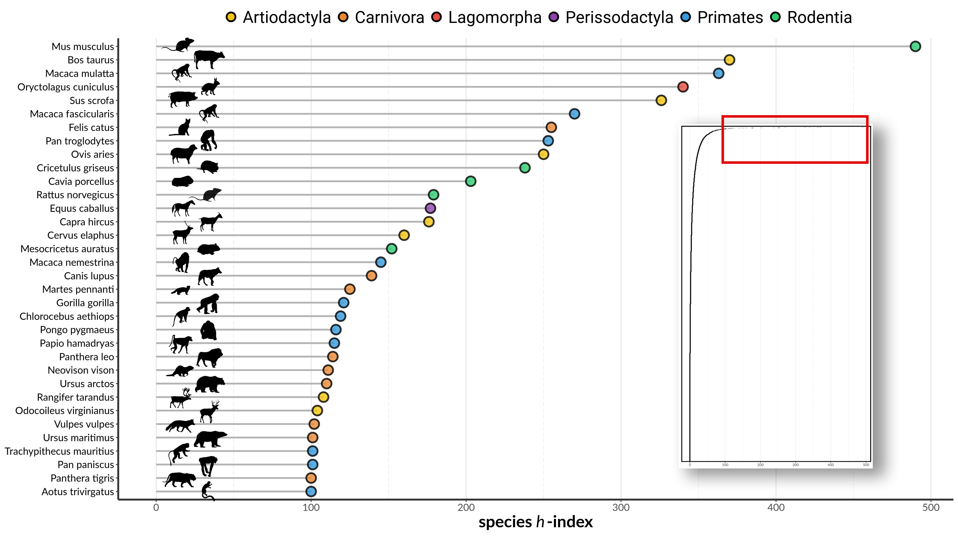

Slide 13
ggplot(data = df,
aes(x = xvar,
y = yvar,
colour = group)) +
geom_point(size = 1.2,
alpha = 0.5) +
labs(x = “Variable x”,
y = “Variable y”,
colour = “Group”) + …
Notes:
- How many people here have used ggplot before?

Slide 14
ggplot(data = df,
aes(x = xvar,
y = yvar,
colour = group)) +
geom_point(size = 1.2,
alpha = 0.5) +
labs(x = “Variable x”,
y = “Variable y”,
colour = “Group”) + …
Basic structure
Notes:
Some ppl pipe their data into the ggplot, I don’t do that but you do you
Variables, what to colour your data by, etc.

Slide 15
ggplot(data = df,
aes(x = xvar,
y = yvar,
colour = group)) +
geom_point(size = 1.2,
alpha = 0.5) +
labs(x = “Variable x”,
y = “Variable y”,
colour = “Group”) + …
Plot type

Slide 16
ggplot(data = df,
aes(x = xvar,
y = yvar,
colour = group)) +
geom_point(size = 1.2,
alpha = 0.5) +
labs(x = “Variable x”,
y = “Variable y”,
colour = “Group”) + …
Labels

Slide 17
ggplot(data = df,
aes(x = xvar,
y = yvar,
colour = group)) +
geom_point(size = 1.2,
alpha = 0.5) +
labs(x = “Variable x”,
y = “Variable y”,
colour = “Group”) + …
Other customisations
Notes:
- Colour palettes, themes, scaling (if you’ve logged your data), changing tick marks, etc.

